Slide 1
What’s Under
the Hood?
Derrick Kearney
HUBzero® Platform for Scientific Collaboration
Purdue University
Original slides by Michael McLennan
This work licensed under
Creative Commons
See license online:
by-nc-sa/3.0

Slide 2
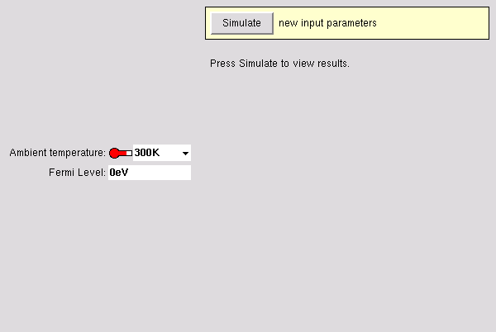
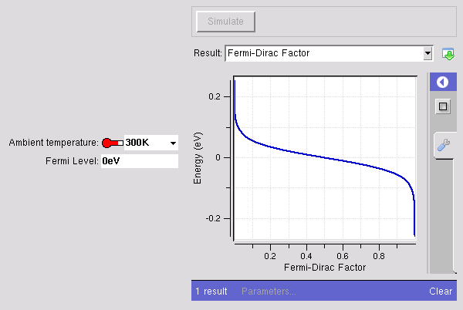
Example: Fermi function tool
curve
number
number
How does it work?

Slide 3

Tool Definition File
Builder
<?xml version="1.0"?>
<run>
<tool>
<about>Press Simulate to view results.</about>
<command>@tool/fermi @driver</command>
</tool>
<input>
<number id="temperature">…</number>
<number id="Ef">…</number>
</input>
<output>
<curve id="f12">…</curve>
</output>
</run>
<XML>
skeleton
program
tool.xml
Info about the tool, how to run it
Input objects
Output objects

Slide 4

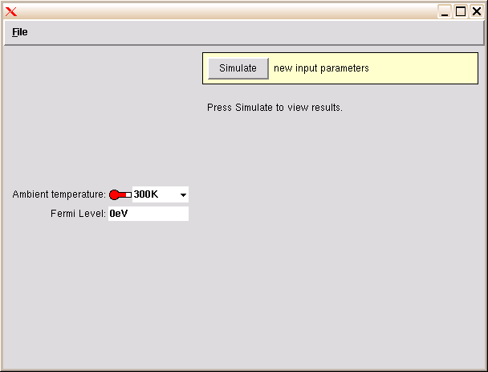
Running produces a driver file
Builder
Runner
<XML>
driver1827.xml
<XML>
tool.xml

Slide 5
Running produces a driver file
<?xml version="1.0"?>
<run>
…
<input>
<number id="temperature“>
<units>K</units>
<min>0K</min>
<max>500K</max>
<default>300K</default>
</number>
<number id="Ef“>
<units>eV</units>
<default>0eV</default>
</number>
</input>
<output>
<curve id="f12">…</curve>
</output>
</run>
<?xml version="1.0"?>
<run>
…
<input>
<number id="temperature“>
<units>K</units>
<min>0K</min>
<max>500K</max>
<default>300K</default>
<current>77K</current>
</number>
<number id="Ef“>
<units>eV</units>
<default>0eV</default>
<current>200meV</current>
</number>
</input>
<output>
<curve id="f12">…</curve>
</output>
</run>
<XML>
<XML>
tool.xml
driver1827.xml

Slide 6
Running your program
Builder
Runner
<XML>
driver1827.xml
Your
Program
<XML>
<XML>
tool.xml
run12703129102.xml

Slide 7
Program produces a run file
<?xml version="1.0"?>
<run>
…
<input>
<number id="temperature“>…
<current>77K</current>
</number>
<number id="Ef“>…
<current>200meV</current>
</number>
</input>
<output>
<curve id="f12“>
<about>…
</curve>
</output>
</run>
<?xml version="1.0"?>
<run>
…
<input>
<number id="temperature“>…
<current>77K</current>
</number>
<number id="Ef“>…
<current>200meV</current>
</number>
</input>
<output>
<curve id="f12“>
<about>…
<component>
<xy>0.999955 -0.25852
0.99995 -0.255935
0.999945 -0.25335…
</curve>
</output>
</run>
<XML>
<XML>
driver1827.xml
run12703129102.xml

Slide 8
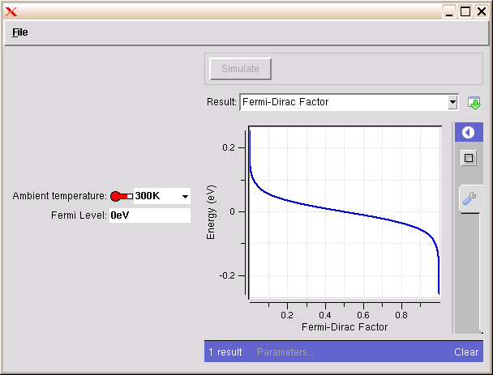

Tool Definition File
Runner
<XML>
driver1827.xml
Your
Program
Results are moved out of
the current working directory
to the “results” directory
<XML>
<XML>
~/data/results/$SESSION
tool.xml
run12703129102.xml

Slide 9
All Together
Builder
Runner
<XML>
driver1827.xml
Your
Program
<XML>
<XML>
tool.xml
run12703129102.xml

Slide 10
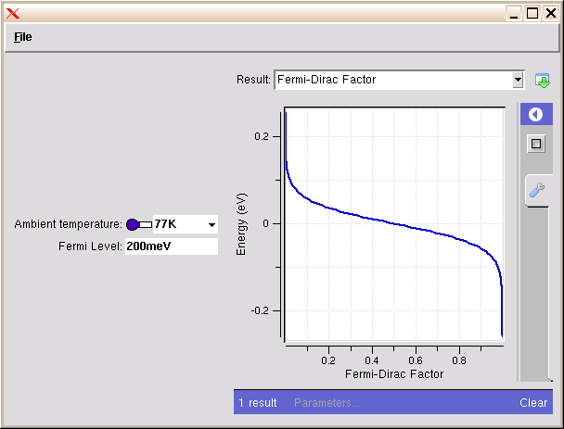
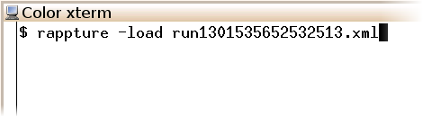
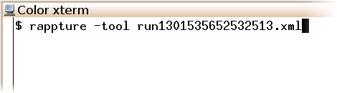
Run file is a complete record of the run
 | Tool Defn | Input Vals | Output Vals
tool.xml | ☑
driver.xml | ☑ | ☑
run.xml | ☑ | ☑ | ☑
<XML>
run12703129102.xml
reload old results
rerun an old tool

Slide 11

How does your program get invoked?
Runner
<XML>
driver1827.xml
Rappture
Rappture
Library
Your
Program
Your
Code
<XML>
<XML>
tool.xml
run12703129102.xml

Slide 12
How your program gets invoked
<?xml version="1.0"?>
<run>
<tool>
<about>Press Simulate to view results.</about>
<command>python @tool/fermi.py @driver</command>
</tool>
<input>
…
<XML>
tool.xml
python /apps/yourtool/current/rappture/fermi.py driver327.xml
import Rappture
import sys
from math import *
io = Rappture.library(sys.argv[1])
Tstr = io.get('input.number(temperature).current')
Efstr = io.get('input.number(Ef).current')
…
Rappture
io.put('output.curve(f12).component.xy', xydata)
Rappture.result(io)
sys.exit()

Slide 13
Object names in tool.xml and in your program
<?xml version="1.0"?>
<run>
…
<input>
<number id="temperature">
<current>300K</current>
</number>
…
</input>
<output>
<curve id="f12">
<component>
<xy>2.102 6.454
…
input
.number(temperature)
.current
<XML>
output
.curve(f12)
.component
.xy
tool.xml
Rappture
…
Tstr = io.get('input.number(temperature).current')
Efstr = io.get('input.number(Ef).current')
io.put('output.curve(f12).component.xy', xydata)
…
Your Program

